Slide 1
Machine Learning
Lecture 03

Slide 2
Linear Regression
A Supervised learning algorithm
Taking input variables and trying to fit the output onto continuous values.
Linear regression with one variable is also known as “Univariate linear regression”.
Univariate linear regression is used when you want to predict a single output value y from a single input value x.
Assumes that there is a linear relation between the input and output, means the output changes at a constant rate as the input changes.
Given the training data with right answers, predict the real-valued output for the test data.

Slide 3
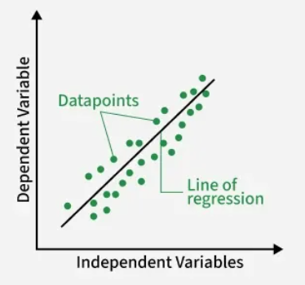

Best Fit line in Linear Regression
It computes the “best-fit” straight-line often using the Hypothesis Function/model $y=mx+c$ or $y’ = hθ\left(x\right)= θ0 + θ1x$
that minimizes the distance/error between observed data points.

Slide 4
Example
We want to predict a student's exam score based on how many hours they studied. We observe that as students study more hours, their scores go up. In the example of predicting exam scores based on hours studied. Here:
Independent variable (input): Hours studied because it's the factor we control or observe.
Dependent variable (output): Exam score because it depends on how many hours were studied.

Slide 5
More Examples
Predicting sales, stock market, trends etc.
Predicting salaries based on experience.
Predicting weight based on height.
Predicting crop yield based on rain fall.
Determining optimal medicine dosage based on blood pressure levels.
Assessing training impact on athlete’s performance.
Estimation of property prices based on location/size.

Slide 6
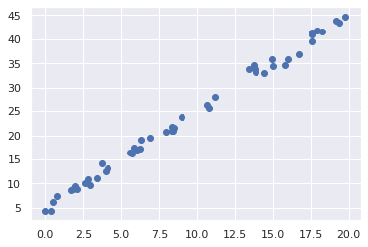
Dataset and Plotted Graph
Input Data (x) | Correct Answer (y)
8.3 | 20.99
14.4 | 32.89
6.05 | 17.08
.. | ..
Price
Size

Slide 7
Dataset and Notations
m = Number of Training Examples
x = Input Variable
y = Output Variable / Target Value
(x, y) is one training example
(x^{(i)},y^{(i)}) is i^{th} training example
(x⁽¹⁾,y⁽¹⁾) = (8.3, 20.99)
Input Data (x) | Correct Answer (y)
8.3 | 20.99
14.4 | 32.89
6.05 | 17.1
.. | ..

Slide 8
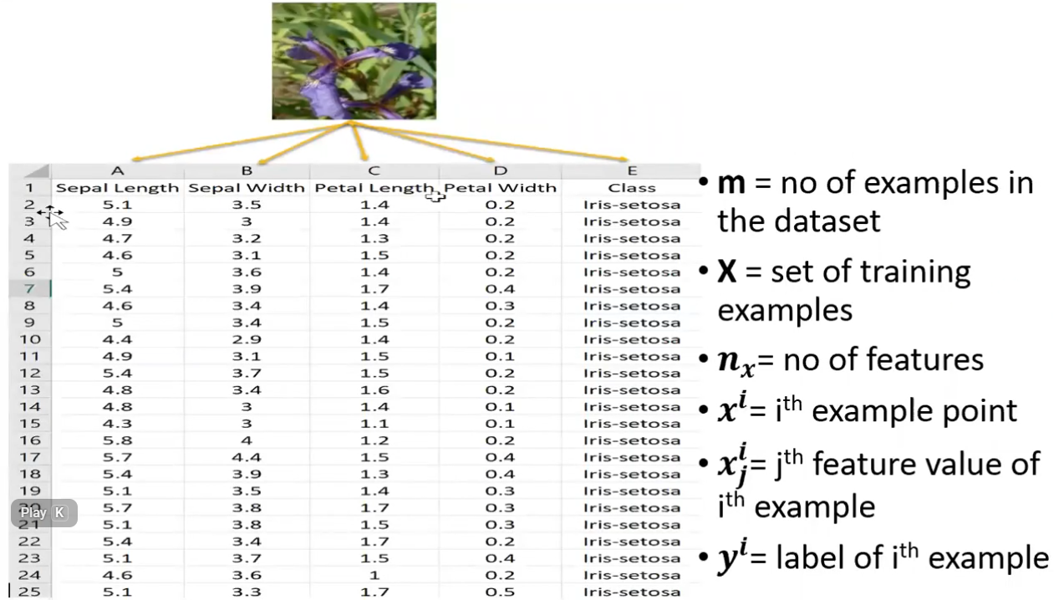

Slide 9
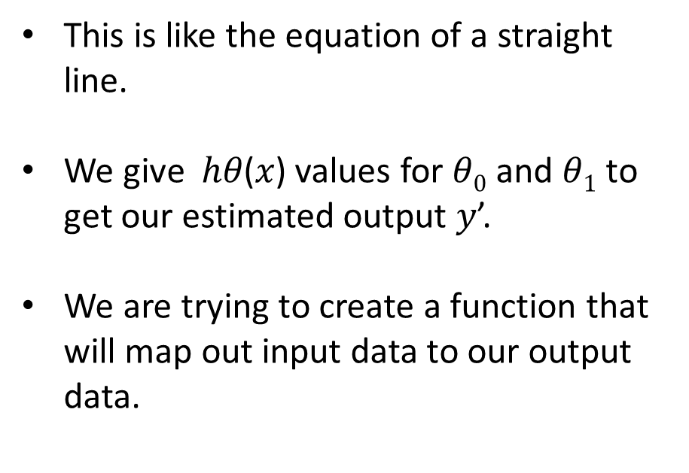
Linear Regression with One Variable
This is like the equation of a straight line.
We give ℎ𝜃​(𝑥) values for $θ0$ and $θ1$ to get our estimated output 𝑦’.
We are trying to create a function that will map out input data to our output data.
Price
Size

Slide 10



Linear Functions With Varying Values of Ɵ

Slide 11
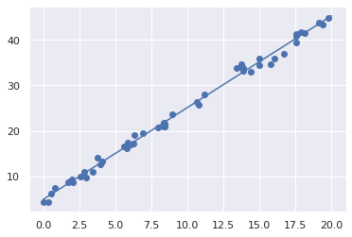

Linear Regression with One Variable
$y’ = hθ(x) = θ0 + θ1x$
Intercept: $θ0=5$
Slope: $θ1$ = $2$
Input Data (x) | Correct Answer (y)
5 | 15
10 | 25
15 | 35
.. | ..
Price
Size

Slide 12
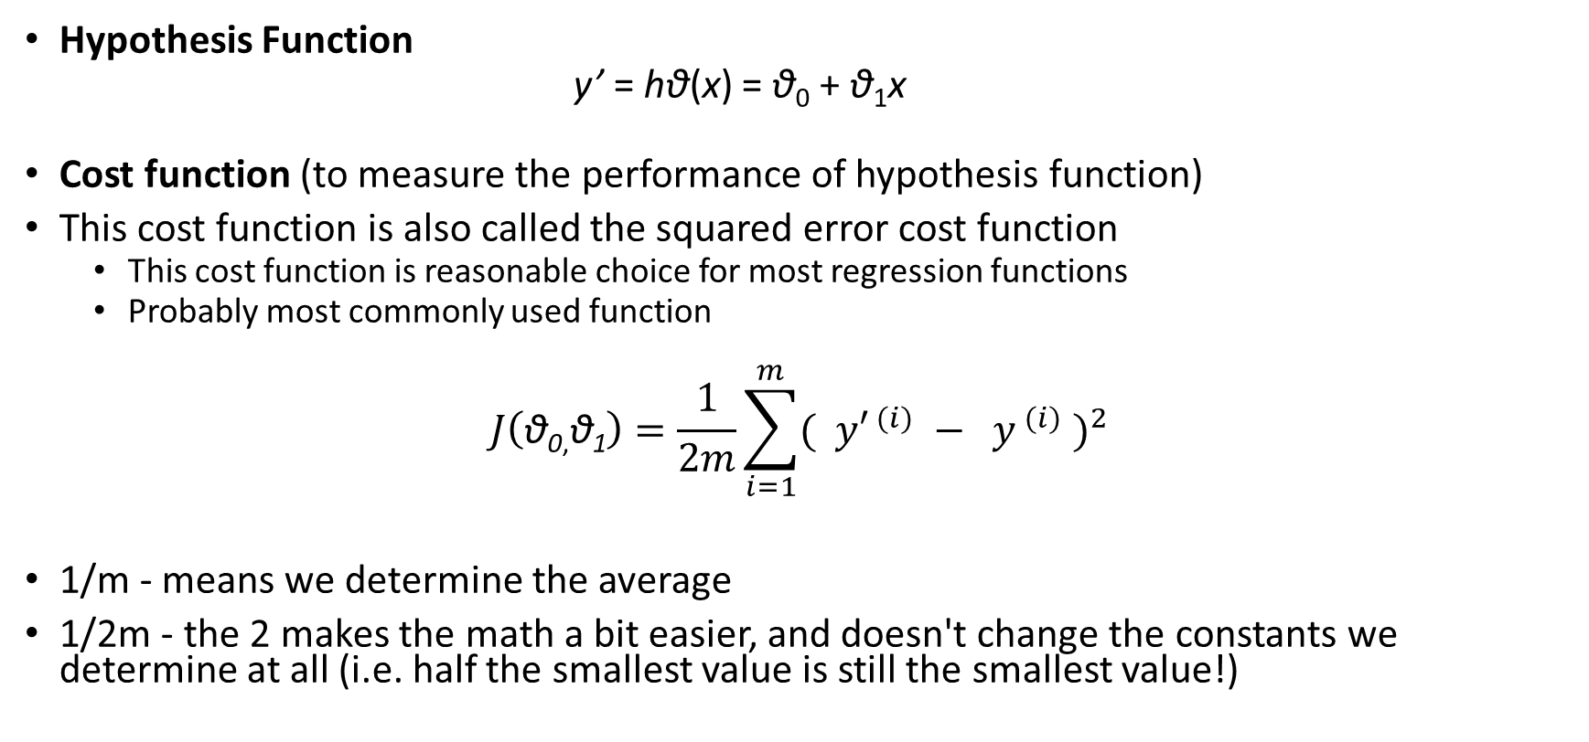
Cost Function
Hypothesis Function
y’ = hθ(x) = θ₀ + θ₁x
Cost function (to measure the performance of hypothesis function)
This cost function is also called the squared error cost function
This cost function is reasonable choice for most regression functions
Probably most commonly used function
$$J\left(\text{θ}\text{0}\text{,}\text{θ}\text{1}\right)=\frac{1}{2m}\sum_{i=1}^{m}{{( {y′}^{ (i)} − y^{ (i)} )}^{2}}$$
1/m - means we determine the average
1/2m - the 2 makes the math a bit easier, and doesn't change the constants we determine at all (i.e. half the smallest value is still the smallest value!)

Slide 13
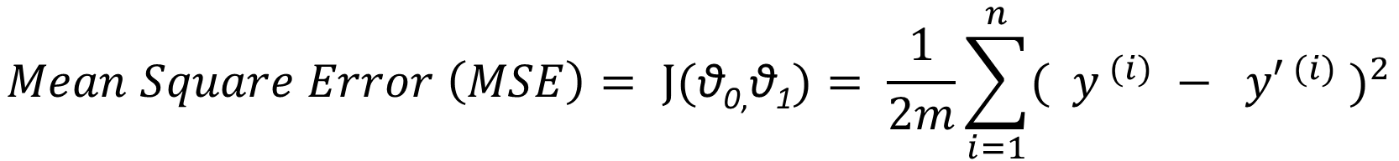
Cost Function
Input Data (x) | Correct Answer (y) | Estimated Answer | Error
8.3 | 20.99 | 21.6 | -0.61
14.4 | 32.89 | 33.8 | -0.81
6.05 | 17.1 | 17.08 | 0.02
.. | .. | .. | ..
$$Mean Square Error \left(MSE\right)= J(\text{θ}\text{0}\text{,}\text{θ}\text{1})= \frac{1}{2m}\sum_{i=1}^{n}{{( y^{ (i)} − {y′}^{ (i)} )}^{2}}$$

Slide 14
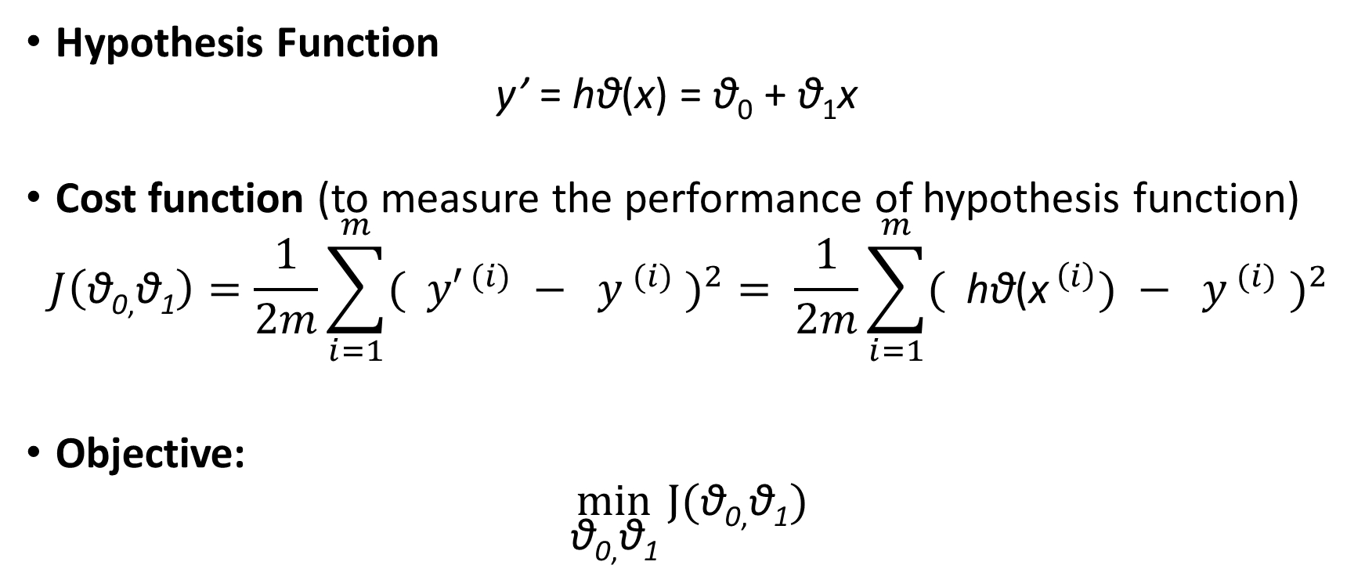
Cost Function
Hypothesis Function
y’ = hθ(x) = θ₀ + θ₁x
Cost function (to measure the performance of hypothesis function)
$$J\left(\text{θ}\text{0}\text{,}\text{θ}\text{1}\right)=\frac{1}{2m}\sum_{i=1}^{m}{{( {y′}^{ (i)} − y^{ (i)} )}^{2}}= \frac{1}{2m}\sum_{i=1}^{m}{{( {\text{h}\text{θ}\text{(}\text{x}}^{ \left(i\right)}) − y^{ (i)} )}^{2}}$$
Objective:
$$\min_{\text{θ}\text{0}\text{,}\text{θ}\text{1}}{J(\text{θ}\text{0}\text{,}\text{θ}\text{1})}$$

Slide 15
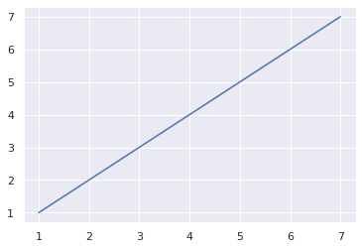
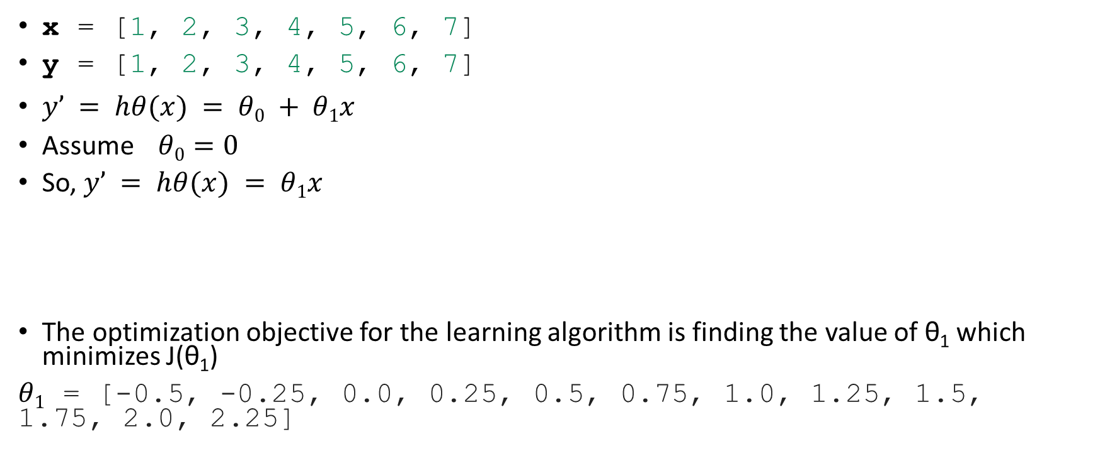
Cost Function
x = [1, 2, 3, 4, 5, 6, 7]
y = [1, 2, 3, 4, 5, 6, 7]
$y’ = hθ(x) = θ0 + θ1x$
Assume $θ0=0$
So, $y’ = hθ(x) = θ1x$
The optimization objective for the learning algorithm is finding the value of θ₁ which minimizes J(θ₁)
$θ1$ = [-0.5, -0.25, 0.0, 0.25, 0.5, 0.75, 1.0, 1.25, 1.5, 1.75, 2.0, 2.25]

Slide 16
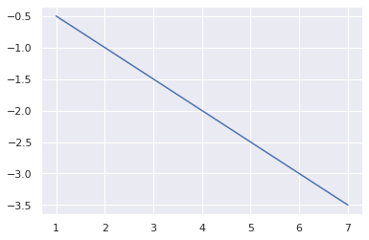
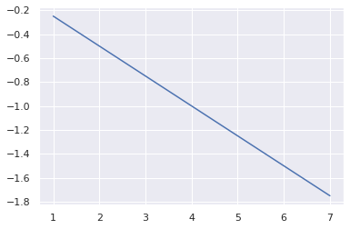
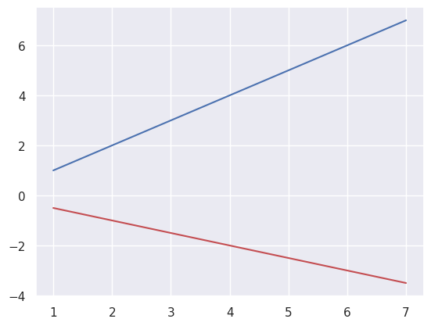
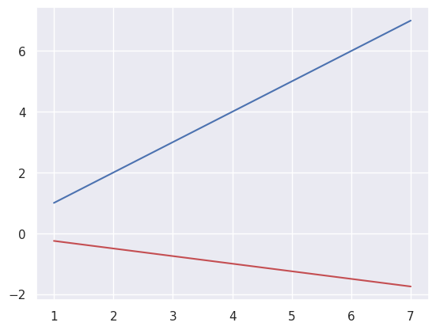
Cost Function - Example
θ₁ = -0.5, J(θ₁)= 45.0
θ₁ = -0.25,J(θ₁)= 31.25

Slide 17
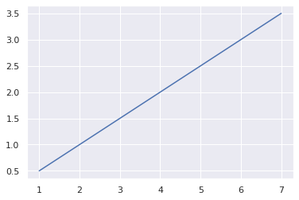
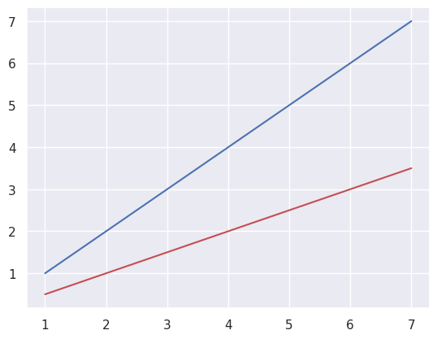
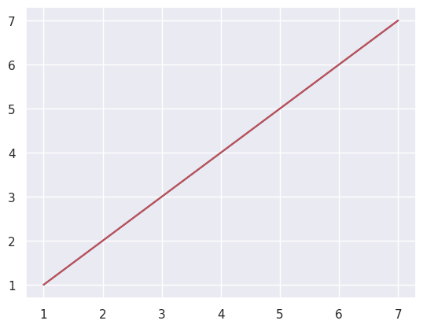
Cost Function - Example
θ₁ = 0.5, J(θ₁)= 5.0
θ₁ = 1.0, J(θ₁)= 0.0

Slide 18
Cost Function - Example
θ₁ = 1.5, J(θ₁)= 5.0
θ₁ = 2.0, J(θ₁)= 20.0

Slide 19
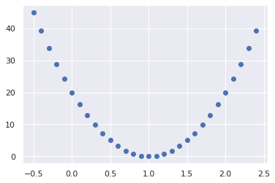

Graph of J(θ₁)
$θ1$ = [-0.5, -0.25, 0.0, 0.25, 0.5, 0.75, 1.0, 1.25, 1.5, 1.75, 2.0, 2.25]
$J(θ1)$ =[45.0, 31.25, 20.0, 11.25, 5.0, 1.25, 0.0, 1.25, 5.0, 11.25, 20.0, 31.25]
The optimization objective for the learning
algorithm is to find the value of θ₁
which minimizes J(θ₁)
So, here θ₁ = 1 is the best value for θ₁
J(θ₁)
θ₁

Slide 20
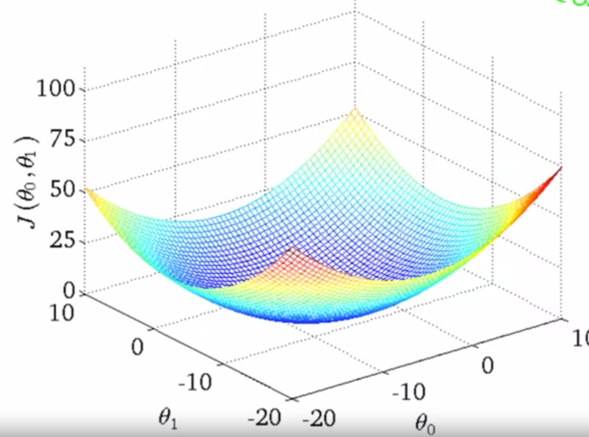
Graph of J(θ_{0 ,} θ₁)
A 3D surface plot
where axis are:
X = θ₁
Z = θ₀
Y = J(θ₀,θ₁)

Slide 21
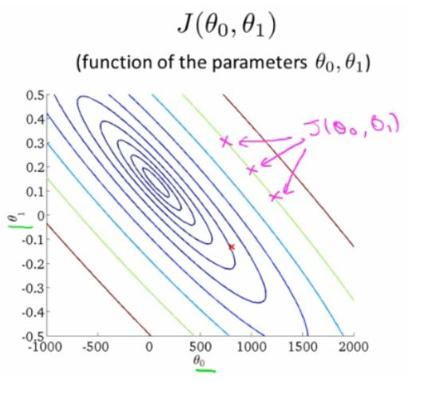
Contour Plot
Each point represents a pair of
parameter values for Ɵ0 and Ɵ1
Our example here put the values at
θ₀ = ~800
θ₁ = ~-0.15
Not a good fit
i.e. these parameters give a value on our
contour plot far from the center.
If we have
θ₀ = ~360
θ₁ = 0
This gives a better hypothesis, but still not
great - not in the center of the contour plot.

Slide 22
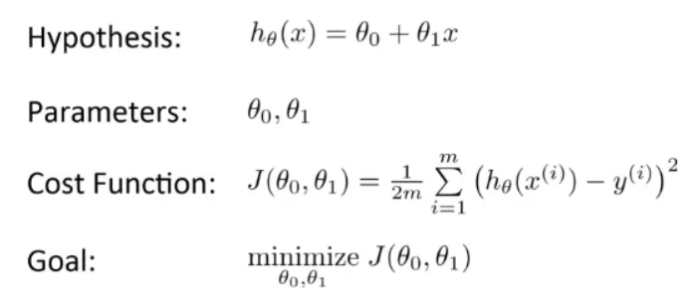
Recap
Univariate Linear Regression

Slide 23
Gradient Descent
Gradient descent is an optimization algorithm used in machine learning to minimize the cost/loss by iteratively adjusting parameters in the direction of the negative gradient, aiming to find the optimal set of parameters.
Gradient descent can be applied to various machine learning algorithms, including linear regression, logistic regression, neural networks, and support vector machine.
It provides a general framework for optimizing models by iteratively refining their parameters based on the cost function.
The algorithm operates by calculating the gradient of the cost function, which indicates the direction and magnitude of the steepest ascent.

Slide 24
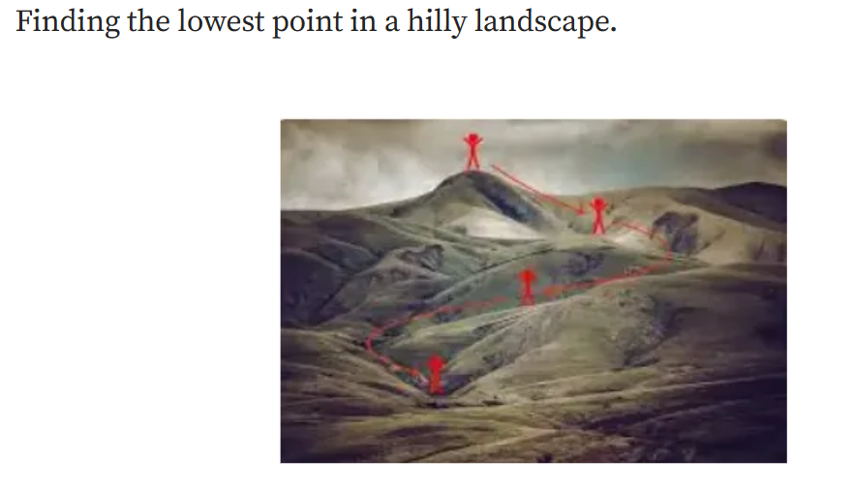
Gradient Descent

Slide 25
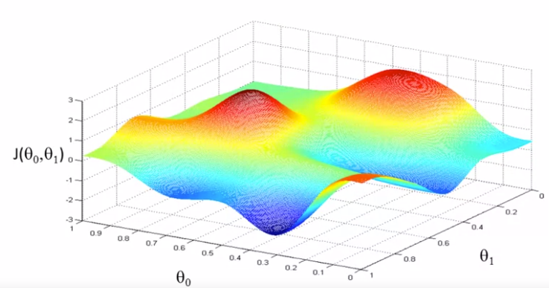
Gradient Descent
We have J(θ_{0 ,} θ₁) and we want min J(θ_{0 ,} θ₁)

Slide 26
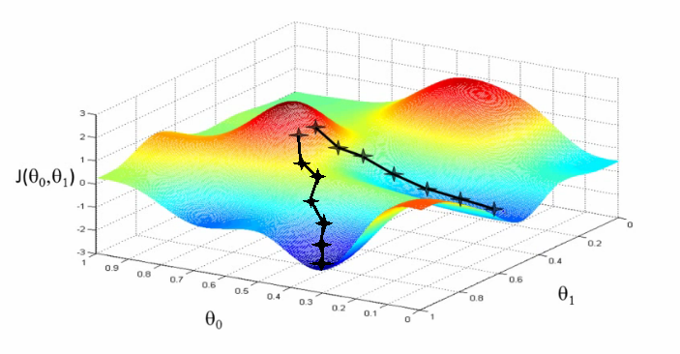
Solving Minimization Problem

Slide 27
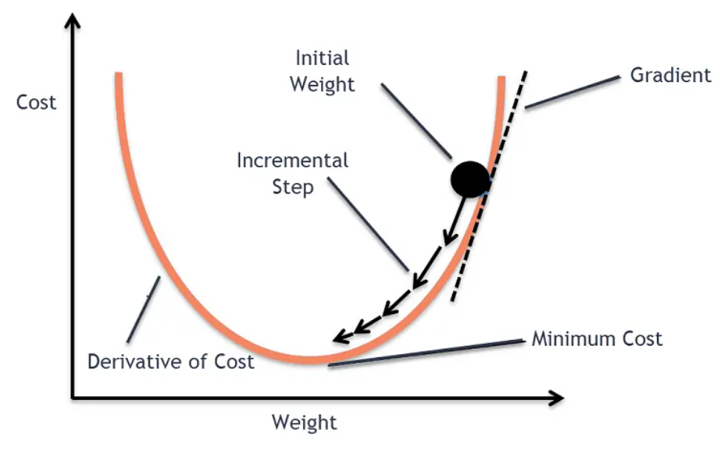
Gradient Descent Algorithm
The goal of the gradient descent algorithm is to minimize the given function (say, cost function). To achieve this goal, it performs two steps iteratively:
Compute the gradient (slope), the first-order derivative of the function at that point.
Make a step (move) in the direction opposite to the gradient. The opposite direction of the slope increases from the current point by alpha times the gradient at that point

Slide 28
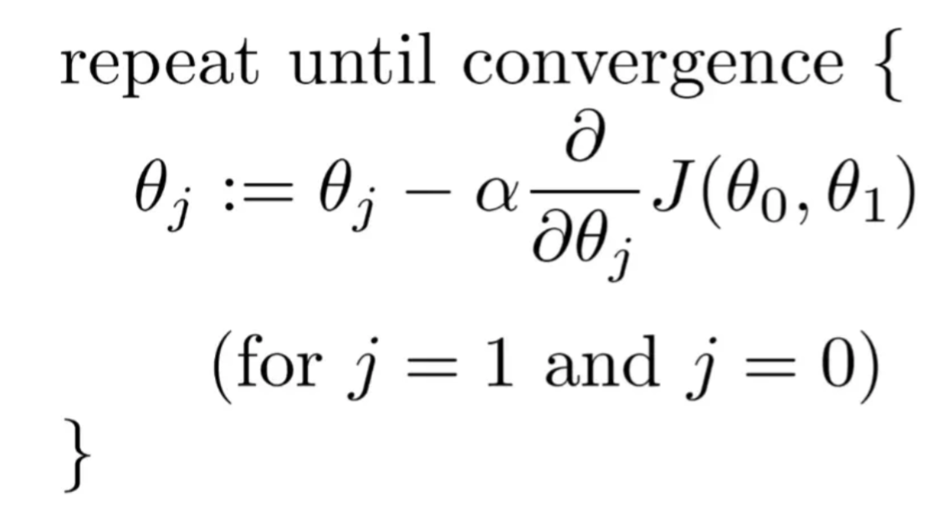
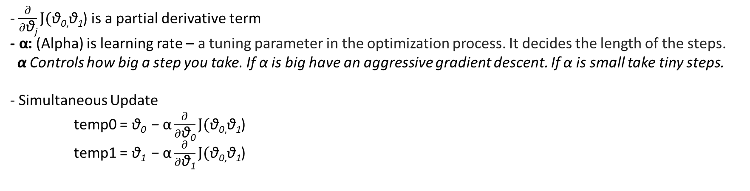
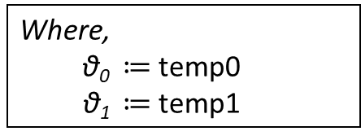
Gradient Descent Algorithm
- $\frac{∂}{∂\text{θ}\text{j}}J(\text{θ}\text{0}\text{,}\text{θ}\text{1}$) is a partial derivative term
$\text{− }\text{α}$: (Alpha) is learning rate – a tuning parameter in the optimization process. It decides the length of the steps.
$\text{α}$Controls how big a step you take. If α is big have an aggressive gradient descent. If α is small take tiny steps.
- Simultaneous Update
temp0 = $\text{θ}\text{0 }\text{−} \text{α}\frac{∂}{∂\text{θ}\text{0}}J(\text{θ}\text{0}\text{,}\text{θ}\text{1}$)
temp1 = $\text{θ}\text{1 }\text{−} \text{α}\frac{∂}{∂\text{θ}\text{1}}J(\text{θ}\text{0}\text{,}\text{θ}\text{1}$)
Where,
$\text{θ}\text{0} ≔$ temp0
$\text{θ}\text{1} ≔$ temp1

Slide 29
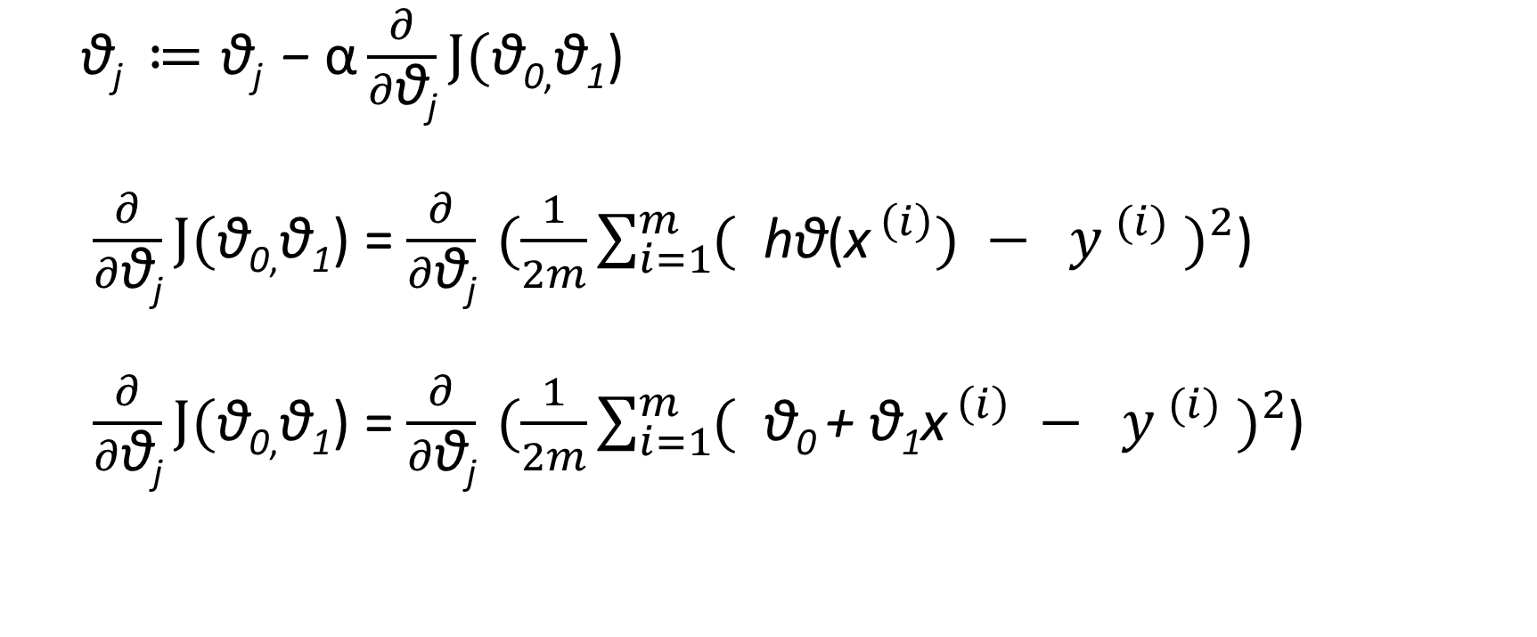
Linear Regression with Gradient Descent
$\text{θ}\text{j} ≔\text{θ}\text{j}\text{ −} \text{α}\frac{∂}{∂\text{θ}\text{j}}J(\text{θ}\text{0}\text{,}\text{θ}\text{1}$)
$\frac{∂}{∂\text{θ}\text{j}}J(\text{θ}\text{0}\text{,}\text{θ}\text{1}$) = $\frac{∂}{∂\text{θ}\text{j}} (\frac{1}{2m}\sum_{i=1}^{m}{{( {\text{h}\text{θ}\text{(}\text{x}}^{ \left(i\right)}) − y^{ (i)} )}^{2}}$)
$\frac{∂}{∂\text{θ}\text{j}}J(\text{θ}\text{0}\text{,}\text{θ}\text{1}$) = $\frac{∂}{∂\text{θ}\text{j}} (\frac{1}{2m}\sum_{i=1}^{m}{{( {\text{θ}\text{0} \text{+ }\text{θ}\text{1}\text{x}}^{ \left(i\right)} − y^{ (i)} )}^{2}}$)

Slide 30
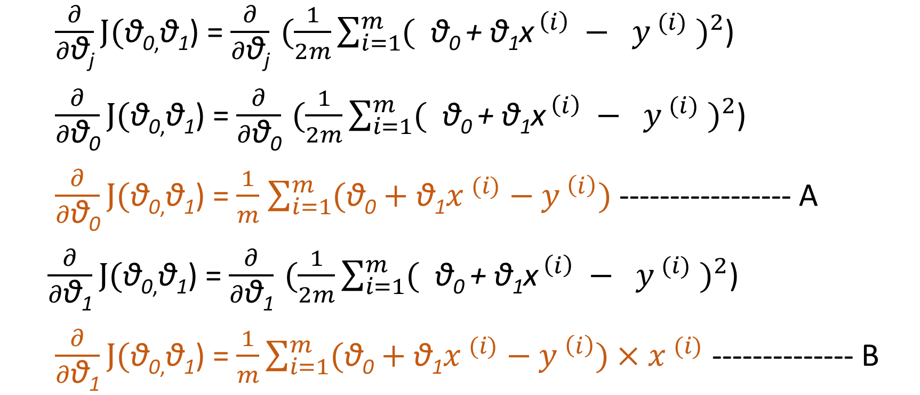
Linear Regression with Gradient Descent
$\frac{∂}{∂\text{θ}\text{j}}J(\text{θ}\text{0}\text{,}\text{θ}\text{1}$) = $\frac{∂}{∂\text{θ}\text{j}} (\frac{1}{2m}\sum_{i=1}^{m}{{( {\text{θ}\text{0} \text{+ }\text{θ}\text{1}\text{x}}^{ \left(i\right)} − y^{ (i)} )}^{2}}$)
$\frac{∂}{∂\text{θ}\text{0}}J(\text{θ}\text{0}\text{,}\text{θ}\text{1}$) = $\frac{∂}{∂\text{θ}\text{0}} (\frac{1}{2m}\sum_{i=1}^{m}{{( {\text{θ}\text{0} \text{+ }\text{θ}\text{1}\text{x}}^{ \left(i\right)} − y^{ (i)} )}^{2}}$)
$\frac{∂}{∂\text{θ}\text{0}}J(\text{θ}\text{0}\text{,}\text{θ}\text{1}$) = $\frac{1}{m}$ $\sum_{i=1}^{m}{(\text{θ}\text{0}}+\text{θ}\text{1}x^{ (i)}−y^{ \left(i\right)})$ ----------------- A
$\frac{∂}{∂\text{θ}\text{1}}J(\text{θ}\text{0}\text{,}\text{θ}\text{1}$) = $\frac{∂}{∂\text{θ}\text{1}} (\frac{1}{2m}\sum_{i=1}^{m}{{( {\text{θ}\text{0} \text{+ }\text{θ}\text{1}\text{x}}^{ \left(i\right)} − y^{ (i)} )}^{2}}$)
$\frac{∂}{∂\text{θ}\text{1}}J(\text{θ}\text{0}\text{,}\text{θ}\text{1}$) = $\frac{1}{m}\sum_{i=1}^{m}{(\text{θ}\text{0}+\text{θ}\text{1}x^{ (i)}−y^{ \left(i\right)})}{×x}^{ (i)}$ -------------- B

Slide 31

Linear Regression with Gradient Descent
Repeat until converge
$\text{θ}\text{0} ≔\text{θ}\text{0} \text{−} \text{α} (\frac{1}{m}\sum_{i=1}^{m}{( {\text{θ}\text{0} \text{+ }\text{θ}\text{1}\text{x}}^{ \left(i\right)} − y^{ \left(i\right)} )}$
$\text{θ}\text{1} ≔\text{θ}\text{1} \text{−} \text{α} (\frac{1}{m}\sum_{i=1}^{m}{( {\text{θ}\text{0} \text{+ }\text{θ}\text{1}\text{x}}^{ \left(i\right)} − y^{ \left(i\right)} )}$ ${\text{x}}^{ \left(i\right)})$
Simultaneous update

Slide 32
Programming Assignment # 1
In this assignment, you are going to train a linear regression model on the given data set.

